Slide 1
Algorithms

Slide 2
Information in this document is subject to change without notice. The example companies, organizations, products, people, and events depicted herein are fictitious. No association with any real company, organization, product, person or event is intended or should be inferred. Complying with all applicable copyright laws is the responsibility of the user.
Microsoft may have patents, patent applications, trademarked, copyrights, or other intellectual property rights covering subject matter in this document. Except as expressly provided in any license agreement from Microsoft, the furnishing of this document does not give you any license to these patents, trademarks, or other intellectual property.
© 2011 Microsoft Corporation. All rights reserved.
Microsoft, MS, Windows, MSDN, Visual Basic, Visual C++, Visual C#, and Visual Studio are either registered trademarks or trademarks of Microsoft Corporation in the U.S.A. and/or other countries.
Other product and company names herein may be the trademarks of their respective owners.
Microsoft Biology Initiative Training by Microsoft Corporation is licensed under a Creative Commons Attribution 3.0 Unported License. Based on a work at research.microsoft.com/bio.

Slide 3
Agenda
Introduction to algorithms
types of algorithms defined in .NET Bio
Alignment algorithms
creating alignments from sequences
creating multi-sequence alignments (3+)
Assembly algorithms
assembling sequence fragments into single sequence
Translation algorithms
transcription and translation
Searching algorithms
pattern matching against sequences
Creating custom algorithms

Slide 4
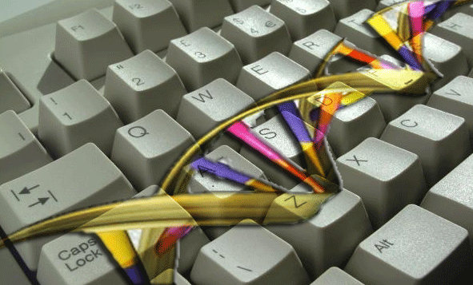
Recap: algorithms
Algorithms perform actions on sequences
output produced is typically algorithm specific, often generates either another sequence or statistics/comparison results
.NET Bio encapsulates algorithms in Bio.Algorithms namespace
most algorithms contained in core Bio.dll assembly
additional algorithms supplied as extension assemblies
supports add-in algorithms for 3rd party extensions as well

Slide 5
Types of algorithms
.NET Bio data structures form the basis for analysis
any algorithm can be programmed on top of it
Several algorithm categories supplied with the framework
sequence aligners (Bio.Algorithms.Alignment)
sequence assemblers (Bio.Algorithms.Assembly)
sequence translators (Bio.Algorithms.Translation)
search pattern match (Bio.Algorithms.StringSearch)
Constructs used internally by algorithms also available
k-mer construction (Bio.Algorithms.Kmer)
suffix tree generation (Bio.Algorithms.SuffixTree)

Slide 6
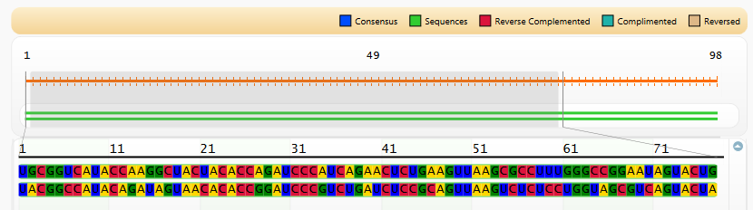
Alignment algorithms
Sequence Aligners identify similar regions between sequences
structural or evolutionary relationships
Encapsulated in .NET Bio using ISequenceAligner interface
aligns 2+ sequences, returns ISequenceAlignment
uses scoring matrix and gap cost to determine similarity
Sequence Assembler sample can align sequences and generate visual comparison

Slide 7
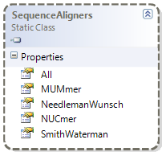
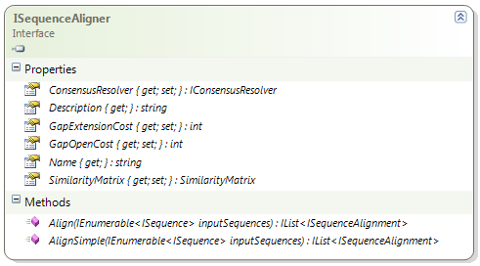
Working with Alignment algorithms
SequenceAligners static class details known algorithms
use All property to retrieve list of known ISequenceAligners
can also use static properties for built-in algorithms
Name and Description provide textual identifiers for algorithm
methods take input ISequences and return sequence alignment results

Slide 8
Built-in alignment algorithms
.NET Bio includes implementations of several standard algorithms
Alignment Algorithm | Description
PairwiseOverlap | Reference implementation of a simple pairwise overlap algorithm for aligning two sequences.
NeedlemanWunsch | Global alignment (where entire sequence is compared) using Needleman-Wunsch algorithm.
SmithWaterman | Local alignment (where partial sequences are compared) using Smith-Waterman algorithm.
MUMmer | Algorithm useful for aligning entire genomes or very large protein sequences.
NUCmer | Algorithm useful for aligning entire genomes or very large DNA sequences.

Slide 9
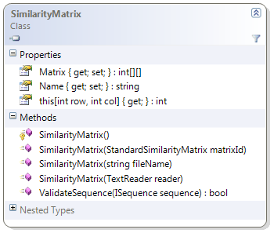
Determining similarities
Sequence alignment evaluation uses scoring matrix
represents the similarity between two data points
higher score given to more-similar symbols, lower to dissimilar
used to determine final score between sequences
SimilarityMatrix should be supplied to alignment algorithm to determine how sequence symbols are matched
matrix can be loaded a variety of ways
Notes:
The scoring matrix describes the probability of a pair occurring in the alignment result. When dealing with proteins, the values in the matrix are typically logarithms of the ratios of two probabilities – whether the result is random, and whether the result is meaningful. These probabilities are derived from actual samples of valid sequences; by adding up these logarithmic probabilities, the algorithm can determine whether the resulting alignment is significant or not – the more positive the score, the more likely the alignment is valid.
When dealing with nucleotide sequences, the matrix is typically much simpler – identifying matches and mismatches only; the process remains identical however – the scores are totaled to determine the overall alignment scoring. Therefore, the output of the algorithm is very much dictated by the matrix used to generate it.

Slide 10
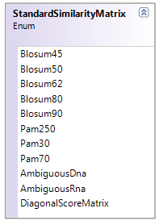
Loading a similarity matrix
.NET Bio comes with standard comparison matrix data
Point Accepted Mutation (PAM) for common protein mutations
Blocks of Amino Acid Substitution Matrix (BLOSUM) for protein evolution
simple DNA / RNA matrix with ambiguous symbol support
diagonal score matrix (A-Z matrix)
var matrix = new SimilarityMatrix(
SimilarityMatrix.
StandardSimilarityMatrix.Pam250);
algorithm.SimilarityMatrix = matrix;
algorithm.AlignSimple(...);
if not supplied, most algorithms default to DiagonalScoreMatrix

Slide 11
Inserting gaps into the alignment
Alignment algorithms can insert gaps as part of process
allows sequences to be aligned by ignoring sections not found in other sequence
Insertions increase uncertainty in the resulting alignment
algorithms use a gap penalty to affect resulting score
Penalty is negative number that is added to scoring matrix values to affect overall alignment score^{[1]}
low gap penalty introduces more gaps, higher match count
high gap penalty drops gap count but will result in lower matches
A---CTG---GGA-CCATG...........
AGGCCT-ATG-GACC-ATG...........
gap insertions allow differing sequences to be aligned
Notes:
[1] Often the penalty itself is based on the scoring matrix used - for example, a gap penalty of -11 is often used with BLOSUM62 and -12 is used with BLOSUM50.

Slide 12
Controlling the gap penalty
ISequenceAligner supports two gap penalty models
AlignSimple uses linear gap model (one gap penalty)
Align uses affine gap model (gap open + gap extension penalty)
Gap Penalty specified through two properties
GapOpenCost – indicates cost for creating new gap
GapExtensionCost – indicates cost of extending an existing gap
IList<ISequenceAlignment> Align(ISequenceAligner algorithm,
ISequence seq1, ISequence seq2)
{
algorithm.GapOpenCost = -4;
return algorithm.AlignSimple(new [] { seq1, seq2 }); }
if not supplied, most algorithms default to (-8) open cost, and (-1) extension cost

Slide 13
Determining consensus
Alignment algorithm uses consensus resolver to define consensus across sequences
assigned through ConsensusResolver property
abstracted by IConcensusResolver interface
defaults to SimpleConsensusResolver type if not assigned
SimpleConsensusResolver uses frequency fraction method
ignores gaps
symbol alphabet based on sequence alphabet
threshold >= 99 uses symbol, otherwise consensus symbol used
can define alternative threshold by creating object deliberately
#1
U
-
G
C
C
-
-
-
U
G
G
-
C
G
G
-
C
C
G
U
A
-
G
C
-
G
#2
-
-
-
-
-
-
-
-
-
G
C
-
G
G
C
-
-
C
A
U
A
-
G
C
-
G
U
-
G
C
C
-
-
-
U
G
S
-
S
G
S
-
C
C
R
U
A
-
G
C
-
G

Slide 14
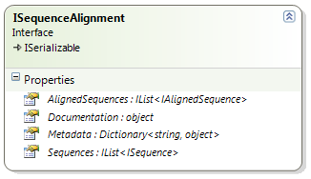
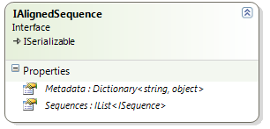
Sequence Alignment results
Alignment algorithms return ISequenceAlignment objects
one object per alignment performed (contained in List<T>)
contains set of IAlignedSequence which describe alignment of two sequences
IAlignedSequence.Metadata returns alignment statistics^{[1]}
"StartOffsets" – start indices of alignment based on input sequence
"EndOffsets" – end indices of alignment based on input sequence
"Insertions" – insertions made to the aligned sequence
"Score" – numeric score of the alignment
"Consensus" – alignment consensus
Notes:
[1] Note that all the keys are strings – you must know what's being stored and check to ensure it is present before assuming the data exists.

Slide 15
Performing an alignment
Select ISequence objects to align
Select alignment algorithm (use SequenceAligners)
Assign SimilarityMatrix for scoring to algorithm (optional)
Assign Gap Penalty(s) to algorithm (optional)
Assign Consensus Resolver (optional)
Call Align or AlignSimple to perform alignment
Parse resulting ISequenceAlignment objects

Slide 16
Example: aligning two sequences
static void Main(string[] args)
{
ISequence seq1 = new Sequence(Alphabets.RNA,
"U-GCC---UGG-CGG-CCGUA-GC-G");
ISequence seq2 = new Sequence(Alphabets.RNA,
"---------GC-GGC--CAUA-GC-G");
var algorithm = SequenceAligners.NeedlemanWunsch;
var results = algorithm.AlignSimple(new [] {seq1, seq2});
var concensus = (ISequence) results[0].AlignedSequences[0]
.Metadata["Consensus"];
Console.WriteLine(new string(concensus.Select(b => (char)b)
.ToArray()));
}
U-GCC---UGS-SGS-CCRUA-GC-G

Slide 17

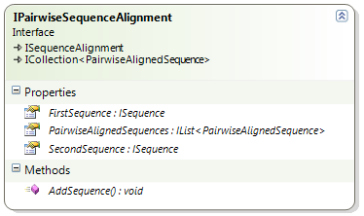
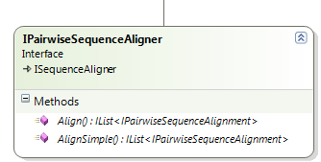
Simplifying alignment work
Pairwise alignments only work with two sequences
encapsulated by simpler IPairwiseSequenceAligner interface
.NET Bio has three common pairwise implementations^{[1]}
Pairwise/Overlap, Smith/Waterman, Needleman/Wunsch
simplified Align and AlignSimple methods take two sequences as input
Notes:
[1] There is also an implementation of MUMmer 3 and NUCmer 3, which are also pair wise alignment algorithms, however they do not implement this simpler interface and are instead driven by the full sequence alignment interfaces.

Slide 18

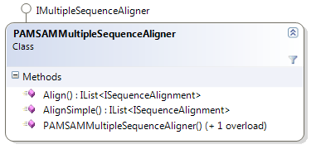
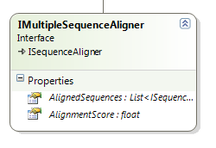
Multiple alignment sequences
PAMSAMMultipleSequenceAligner implements optimized multiple sequence alignment algorithm
produces a sequence alignment using three or more sequences
based on MUSCLE algorithm
uses .NET 4.0 Parallel Extensions to take advantage of multicores
included in Tools\Bin\Bio.PamSam.dll
Algorithm defined by IMultipleSequenceAligner interface
defines score as floating point value

Slide 19
Building custom alignment algorithms
Implement base interfaces to work with .NET Bio
ISequenceAligner
IPairwiseSequenceAligner
IMultipleSequenceAligner
For pairwise alignment algorithms types can derive from abstract class DynamicProgrammingPairwiseAligner
implementation based on standard sequence analysis text^{[1]}
must implement abstract methods to define cell bounds
must implement Traceback method to perform alignment
Make sure to read through supplied algorithm source code
every algorithm cites academic source in header comments
each was designed to be easily readable and understandable
Notes:
[1] Specifically, chapter 2 of Biological Sequence Analysis by Durbin, Eddy, Krogh and Mitchison.

Slide 20
Sequence Assembler algorithms
Sequence Assemblers merge sequence fragments
sequencing generates 1000-2000 pairs at a time (a read)
assemblers combines read fragments into full sequence
overlaps must be discarded/merged
Original DNA
Sequenced
Fragments
T
A
A
C
C
T
T
T
A
G
G
A
C
G
G
T
C
C
G
G
A
A
G
C
C
G

Slide 21
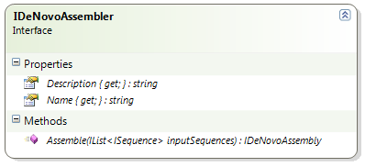
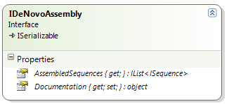
Sequence Assembler algorithms
.NET Bio provides built in support for DeNovo style assembler
creates distinct new sequence from fragments
encapsulated in IDeNovoAssembler interface
Assembler result returned as IDeNovoAssembly interface
primary result is assembled sequence

Slide 22
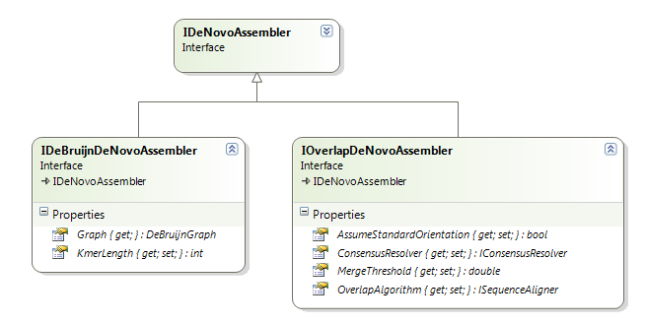
Sequence Assembler algorithms
Two common assembly techniques provided in the framework
IDeBruijnDeNovoAssembler – De Bruijn directed graph used to identify overlapping symbols (most common)
IOverlapDeNovoAssembler – uses pairwise sequence aligner to identify overlapping symbols through consensus
core interfaces model these two techniques and provide contracts to implement specific algorithms

Slide 23
Supplied Sequence Assemblers
Two concrete versions of assembler included
OverlapDeNovoAssembler included in core assembly
ParallelDeNovoAssembler in Tools\Bin\Bio.Padena.dll
OverlapDeNovoAssembler provides simple assembler
implements IOverlapDeNovoAssembler
uses a greedy DNA assembler algorithm
ideal for short sequence fragments
ParallelDeNovoAssembler provided as optional component
designed as a high-performance assembler example in .NET^{[1]}
uses .NET Parallel Extensions to exploit multiple cores
based on a de Bruijn graph (IDeBruijnDeNovoAssembler)
Notes:
[1] There is an extensive design document on the assembler available from http://bio.codeplex.com/Project/Download/FileDownload.aspx?DownloadId=117097

Slide 24
Steps to using assembly algorithms
Load all sequence fragments into an array (or List)
Decide on the assembler algorithm to use
Optionally supply additional parameters to assembler
Call Assemble and pass IEnumerable of sequences
Result is assembled sequence

Slide 25
Example: Assembler
Assemblers consume 2+ sequences
overlaps are detected and merged into final sequence
with the overlap assembler, you can specify the algorithm used to detect overlaps
ISequence seq1 = new Sequence(Alphabets.DNA, "AAACTCGCCTGCTTATCAA");
ISequence seq2 = new Sequence(Alphabets.DNA, "TATCAACCCTTAGAGAGCC");
ISequence seq3 = new Sequence(Alphabets.DNA, "AGAGCCAACTATTCGTCCG");
OverlapDeNovoAssembler assembler = new OverlapDeNovoAssembler();
assembler.OverlapAlgorithm = SequenceAligners.SmithWaterman;
var results = assembler.Assemble(new[] { seq1, seq2, seq3 });
Console.WriteLine(new string(results.AssembledSequences[0]
.Select(b => (char) b).ToArray()));
AAACTCGCCTGCTTATCAACCCTTAGAGAGCCAACTATTCGTCCG

Slide 26
Sequence Translator Algorithms
Sequence translation is a primary event in analysis
DNA → RNA transcription and RNA → DNA reverse transcription
RNA → Protein translation
codon translation of RNA triplet → Amino Acid
Translation classes contained in Bio.Algorithms.Translation
3'
5'
A
C
T
G
T
A
C
C
C
C
A
T
G
T
G
T
G
T
A
C
T
G
C
C
C
5'
3'
T
G
A
C
A
T
G
G
G
G
T
A
C
A
C
A
C
A
T
G
A
C
G
G
G
U
G
A
C
A
U
G
G
G
G
U
A
C
A
C
A
C
A
U
G
A
C
G
G
G
*
H
G
V
H
T
*
R
* represents termination character in Amino Acid

Slide 27
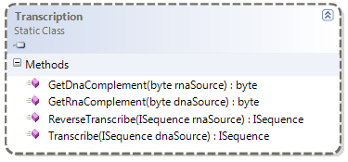
Transcription
RNA transcription is performed by Transcription class
static methods perform work on sequences or nucleotides (bytes)
ISequence dnaSequence = new Sequence(Alphabets.DNA,
"ACTGTACCCCATGTGTGTACTGCCC");
ISequence rnaSequence = Transcription.Transcribe(dnaSequence);
UGACAUGGGGUACACACAUGACGGG

Slide 28
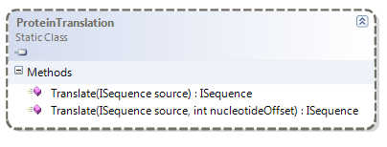
Translation
Protein translation performed by ProteinTranslation class
takes input sequence and optional starting position
returns ISequence of AminoAcid elements
ISequence dnaSequence = new Sequence(Alphabets.DNA,
"ACTGTACCCCATGTGTGTACTGCCC");
ISequence rnaSequence = Transcription.Transcribe(dnaSequence);
ISequence aminoAcids = ProteinTranslation.Translate(rnaSequence);
*HGVHT*R

Slide 29
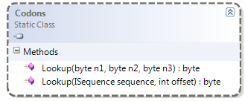
RNA triplets to Amino Acid
ProteinTranslation class internally uses Codons class
maps RNA triplets into appropriate Amino Acid
can be used directly as well
can lookup using three RNA nucleotides, or by indexing into a sequence
static void Main(string[] args)
{
RnaAlphabet al = RnaAlphabet.Instance;
byte aa = Codons.Lookup(al.C, al.A, al.U);
if (aa == (byte)'H') { ... }
}

Slide 30
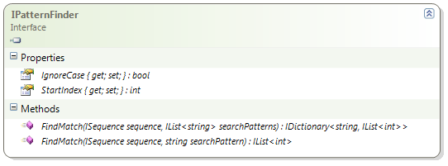
Searching sequences
IPatternFinder interface used to define sequence searching
interface to locate matches within a sequence
FindMatch method takes an input sequence and pattern and returns indices where matches occur
.NET Bio provides a single implementation - BoyerMoore
based on efficient Boyer-Moore string searching algorithm
can change search start and case sensitivity
interface declares both single-string and multi-string search capabilities

Slide 31
BoyerMoore sequence searching
BoyerMoore class performs efficient search of sequence
minimal memory consumption while searching
performs multi-string search in parallel (on multiple cores)
returns IList<int> representing hit positions
ISequence sequence = new Sequence(Alphabets.DNA, "...");
IPatternFinder ss = new BoyerMoore() { IgnoreCase = true };
IDictionary<string, IList<int>> results =
ss.FindMatch(sequence, new[] {"CCC", "AAA", "GGG", "TTT"});
foreach (var match in results)
Console.Write("{0}={1} matches ", match.Key, match.Value.Count);
}
CCC=7 matches AAA=3 matches GGG=2 matches TTT=2 matches

Slide 32
Defining your own algorithms
Should prefer to implement any interfaces defined in .NET Bio
allows reuse in the library, for example when supplying a sequence alignment algorithm to an ordered sequence assembler
Read the .NET Bio source code and samples
lots of great examples
code designed to be easily consumed and modified
Reuse code if possible, several utility classes in algorithms
K-mer creation (SequenceToKmerBuilder)
Suffix-tree builder (KurtzSuffixTreeBuilder)
Check the documentation at http://bio.codeplex.com
some algorithms have dedicated design documentation

Slide 33
Summary
.NET Bio has support for standard bioinformatics algorithms
sequence alignment
sequence assembly
translation
sequence searching
Almost everything is defined in terms of interfaces
programming against the interfaces allows transparency
allows for extension and versioning as well
Can define your own algorithms
even make them visible through add-in registration

Slide 34
Disclaimer: This document is provided "as-is". Information and views expressed in this document, including URL and other Internet Web site references, may change without notice. You bear the risk of using it.
This document does not provide you with any legal rights to any intellectual property in any Microsoft product. You may copy and use this document for your internal, reference purposes.
© 2011 Microsoft Corporation. All rights reserved.
Microsoft, Visual Studio, and Windows are trademarks of the Microsoft group of companies. All other trademarks are property of their respective owners.

